Slide 1

Financial Analytics and Machine Learning
Prof. Simona Paravani-Mellinghoff, Prof. Fabrizio Coiai| UCL Institute of Finance and Technology
s.paravani@ucl.ac.uk

Slide 2
Focus of the day
Supervised vs unsupervised learning: an introduction
Natural language processing
NLP and the construction of sentiment indicators
Let’s practice

Slide 3
Machine Learning in Finance Intro to key techniques

Slide 4
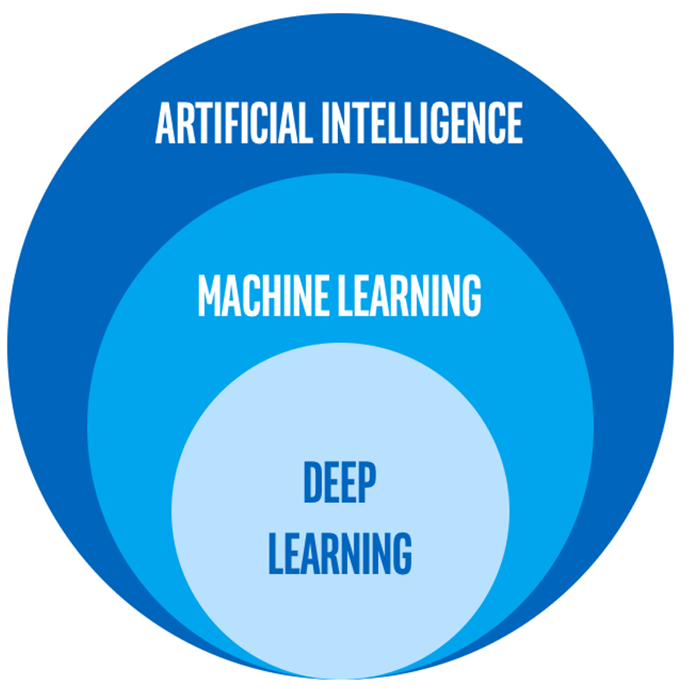
A bit of terminology first
Source: https://www.intel.com/content/www/us/en/artificial-intelligence/posts/difference-between-ai-machine-learning-deep-learning.html

Slide 5
Supervised vs Unsupervised Learning

Slide 6
Supervised vs Unsupervised Learning
Definition of ML: “Algorithms that parse data, learn from that data, and then apply what they’ve learned to make informed decisions”( source: www.towardsdatascience.com)
In machine learning, we have two types of “tasks”: supervised and unsupervised
Most of the course will focus on supervised learning
Typical ML algos: regression, naïve bayes, artificial neural networks and random forest

Slide 7
Supervised learning
Supervised learning is when we have an existing structure for the data that enables us to “label” our data as input (x) and output(y) and the goal is to establish a relationship between the input and the output.
Typical applications: regression and classification problems

Slide 8
Unsupervised learning
Unsupervised learning is used when we want to explore the underlying structure of the data without explicitly labelling the data.
Used primarily for:
Clustering problems: e.g. customer segmentation
Dimensionality reduction: representation of data using fewer features

Slide 9
Natural Language Processing

Slide 10
Natural Language Processing (NLP)
NLP is the application of tasks that understand the human language: speech recognition, translation, finding synonyms
Key uses:
Search engines, spam filters, social media push
In finance, it is primarily used for building sentiment/news-flow based indicators.

Slide 11
NLP Basics
Sentence tokenization
Word tokenization
Text lemmatization and stemming
Stop Words
Feature Extraction/Mapping
BoW
Sparse Vectors Challenge

Slide 12
Tokenization is the process of splitting a text into a list of tokens. Tokenization can separate sentences, words, characters, or subwords. When we split the text into sentences, we call it sentence tokenization. For words, we call it word tokenization
a sentence is a token in a paragraph
a word is a token in a sentence

Slide 13
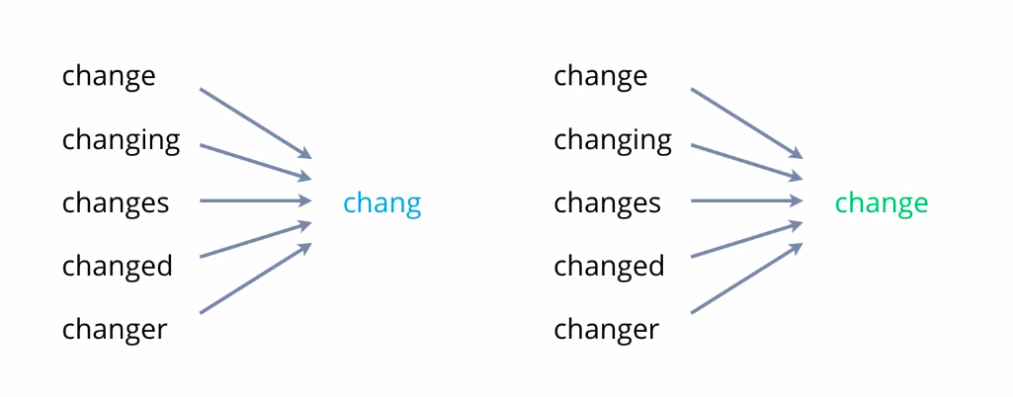
3. Text Lemmatization and Stemming
Stemming removes or stems the last few characters of a word. This can sometimes lead to incorrect meanings and spelling. Lemmatization considers the context and converts the word to its meaningful base form, which is called Lemma.
Stemming ➔
⬅ Lemmatization

Slide 14
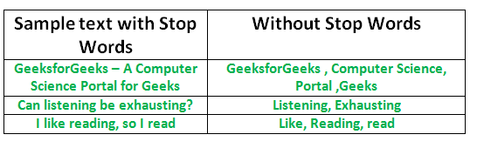
4. Stop Words
Stop words are any word in a stoplist which are filtered out before or after processing of linguistic data. Some examples of stop words are “a”, “the”, “is”, “i”, “so”, “are”, “for”, “be”, etc.

Slide 15
5. Feature Extraction/Mapping
Machines cannot process raw text in order to be used as quantifiable inputs and outputs by the ML models. NLP methods require encoding of texts into numbers.
This process converts texts into meaningful numeric or vector representation such that the context and relationship among characters in sentences are preserved and is sufficient for the machine to pick the signals associated with different combinations of letters, digits, non-numeric characters, and context in sentences.
Some of the popular feature extraction/mapping methods include bag of words, TF-IDF encoding, word2vector and BERT, index-based encoding.

Slide 16
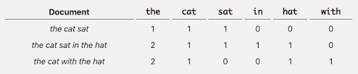
6. Bag of words (BoW)
A bag-of-words is a representation of text that describes the occurrence of words within a document. It involves:
- A vocabulary of known words
- A count of known words.

Slide 17
NLP continued: BOW &TF-IDF
Word frequency in a document or a body of documents; no reference to context
Term Frequency-Inverse Document Frequency (TF-IDF)
The more frequently a word appears in a document, the more its importance increases; the more documents a word appears in, the more its importance decreases
Intuition: downplay words like definite or indefinite articles
Higher complexity
Source: https://quantdare.com/encoding-financial-texts-into-dense-representations/

Slide 18
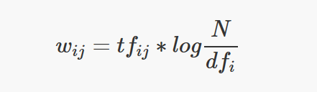
NLP continued: TF-IDF
where:
w_{ij} is the TF-IDF of word i in document j
tf_{ij} is the number of occurrences of word i in document j
N is the number of documents
df_{i} is the number of documents containing word i at least once
Source: https://quantdare.com/encoding-financial-texts-into-dense-representations/

Slide 19
7. Sparse Vectors Challenge
A sparse vector is a vector that has a large number of zeros. It takes unwanted space to store these zeroes. The task is to store a given sparse vector efficiently without having to store the zeros.

Slide 20
NLP continued: sentiment analysis
Sentiment analysis is a well-known researched area in computational text analysis.
Key considerations:
Domain specificity: this is very relevant in financial modelling as words may have different connotations than in every-day parlance; preference for use of LM lexicon vs GI.
Complexity: composition/context
Lexical methodology where words are pre-assigned a sentiment score , usually 1,0,-1
Enhanced lexical methodology: Vader is a sentence-level sentiment classiﬁer. It combines a lexicon which classifies words from +4 to -4 (most positives to most negative) and set of heuristic rules to help contextualise; Vader has been developed for social media and its efficacy in finance is more questionable.

Slide 21
NLP (continued): Vader heuristic rules
Punctuation — I love pizza vs I love pizza!!
Capitalization — I’m hungry!! vs I’M HUNGRY!!
Degree modifiers (use of intensifiers) — I WANT TO EAT!! VS I REALLY WANT TO EAT!!
Conjunctions (shift in sentiment polarity, with later dictating polarity) — I love pizza, but I really hate Pizza Hut (bad review)
Preceding Tri-gram (identifying reverse polarity by examining the tri-gram before the lexical feature) — Canadian Pizza is not really all that great.
Source: https://towardsdatascience.com/https-towardsdatascience-com-algorithmic-trading-using-sentiment-analysis-on-news-articles-83db77966704

Slide 22
NLP Continued: Sources of data
Impossible to draw an exhaustive list, but a few to be familiar with:
NYT
Yahoo
Thomson Reuters Machine Readable News
LexisNexis

Slide 23
NLP and sentiment indicators
Sentiment indicators in finance:
Measures of how a group (e.g. investors, businesses, experts) perceives the state of markets/economy/sectors/specific company
Survey based sentiment indicators of the economy (University of Michigan and Conference Board)
In finance, often used as contrarian indicator that work best at extreme readings (e.g. bull/bear ratios)

Slide 24
NLP and Finance: A Case Study

Slide 25
Review and discussion of the paper “Measuring News Sentiment”
Shapiro, Adam Hale, Moritz Sudhof, and Daniel Wilson. 2017. "Measuring News Sentiment," Federal Reserve Bank of San Francisco Working Paper 2017-01

Slide 26
All materials, including video lectures, can be used only and exclusively in relation to the Financial Analytics and Machine Learning course for the MSc in Banking and Digital Finance 2020/2021.No download, dissemination or reproduction is allowed.

